Slide 1

WHY IS IT IMPORTANT TO LEARN LANGUAGES?

Slide 2


What can you do if you know languages well?
You can have more friends- also from Poland, from your house you can chat with other teenagers.
You can travel a lot- you know how to communicate with other people.

Slide 3


Slide 4
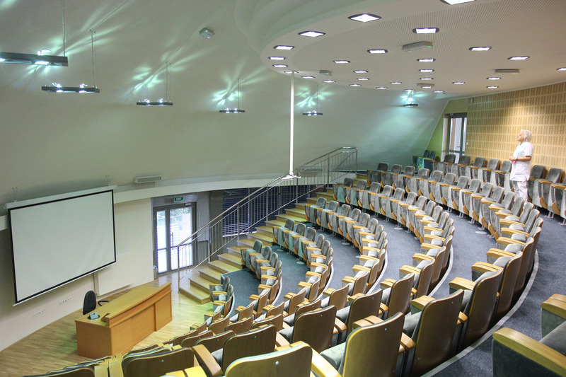

It will be easier for you to get to your dream secondary school or studies.
In the future it will be easier for you to find a good job- in our society it’s important to know foreign languages.

Slide 5


You can have fun- it’s a wonderful feeling (and I know what I’m talking about) when you understand songs or films without any subtitles.
Your brain works better- if you learn another language, you remember things better, even what to buy in shop.

Slide 6











You know other cultures- it’s easier for you to understand people and their behaviour, so you’re nicer for them and they are nicer for you☺
Your self-esteem rises- we gain the conviction that nothing is impossible for us.

Slide 7

Even in Poland if you don’t know English, it will be hard for you to communicate with other people. Most of people use some borrowed from other languages words (e.g. boss), which you won’t understand. Or when a tourist asks you for directions, you won’t know what to answer.

Slide 8
SO LEARN LANGUAGES!!!

Slide 9
THANK YOU FOR WATCHING
Przygotowała:
Malwina Łoboda

